Slide 1
John F. Kennedy Assassination
November 22, 1963
“If anybody really wanted to shoot the President of the United States, it was not a very difficult job – all one had to do was get [on] a high building some day with a telescope rifle, and there was nothing anybody could do the defend against such an attempt.” – Kennedy (Nov. 22, 1963)

Slide 2
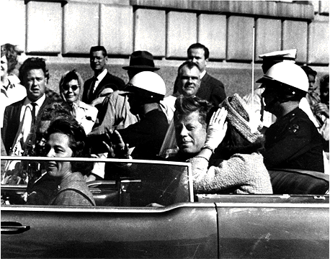
President Slain in Dallas Motorcade
On a 2-day, 5-speech “nonpolitical” tour of politically divided Texas
  Heal the breach between liberal and conservative Texas Democrats
Political tensions almost cancelled his trip – unusually radical mood in the state
  Dallas – high homicide rate, mainly white collar workers influenced by right-wing extremists.
  LBJ had been hissed and spat on by a mob in November of 1960; U.S. Ambassador to UN, Adlai E. Stevenson was abused by anti-UN demonstrators in 1963
Notes:
Feud among party leaders in Texas could jeopardize his reelection chances but he wanted to bring Democrats together in Texas.
Relatively small but vocal group of extremists contributed to the political tensions and knew they were likely to make their presence felt in TX (particularly Dallas).

Slide 3
Texas Continued
Special Presidential limousine – protective clear-plastic bubble-top removed – with wife, Jacqueline and Texas Governor and Mrs. John B. Connally.
  Followed by a secret service sedan (8 service men), which was followed by an open convertible with Mr. and Mrs. Johnson and Senator Ralph W. Yarborough.
Shots were fired as the President approached the Triple Underpass (near the end of the 10-mile ride)
  Came from a 6th floor window of the Texas School Book Depository Building
2 bullets hit the President – one through his neck while the other shattered the right side of his skull
  One of the bullets passed through Kennedy and hit Gov. Connally, who was in front of the President (smashed 3 ribs, punctured his lung, broke his right wrist and penetrated his left thigh).
4th President to be assassinated in office
Notes:
Protective cover was removed because the morning rain had cleared and the Kennedy’s didn’t want to be distant from the people – wasn’t part of the Kennedy mystique.
Johnson took the Presidential oath of office aboard Air Force One before the plane left Dallas, with his wife on his right, and Jacqueline Kennedy at his left (in her clothes still splattered with her husband’s blood).
William Henry Harrison
Abraham Lincoln
James Garfield

Slide 4
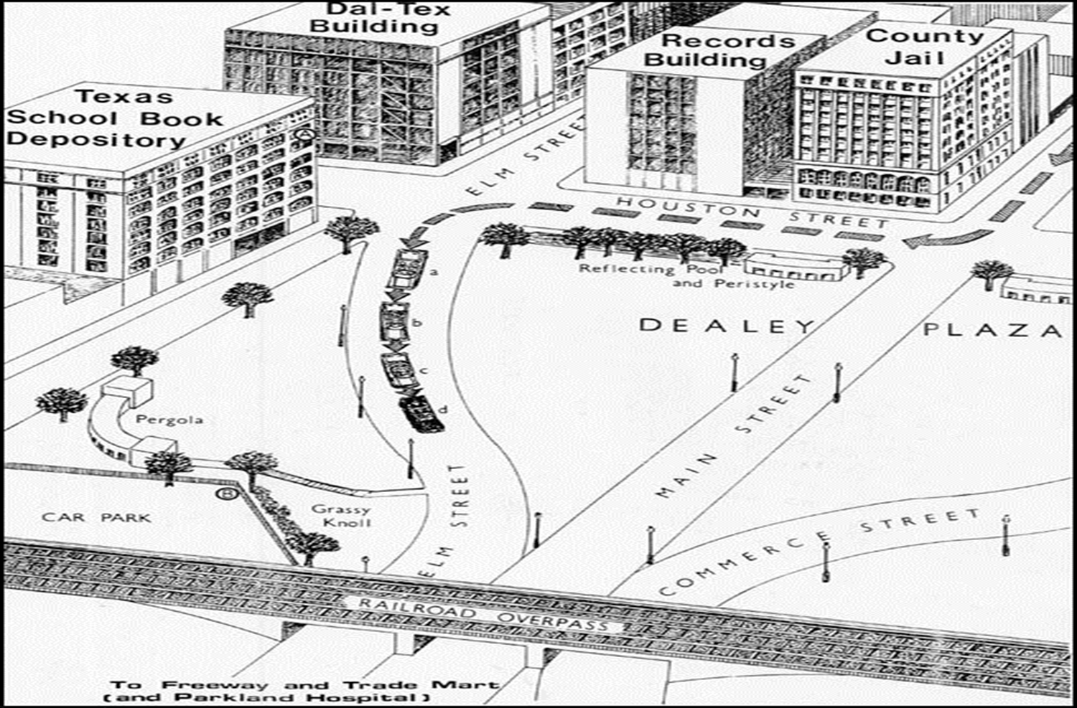
Dealey Plaza Map

Slide 5
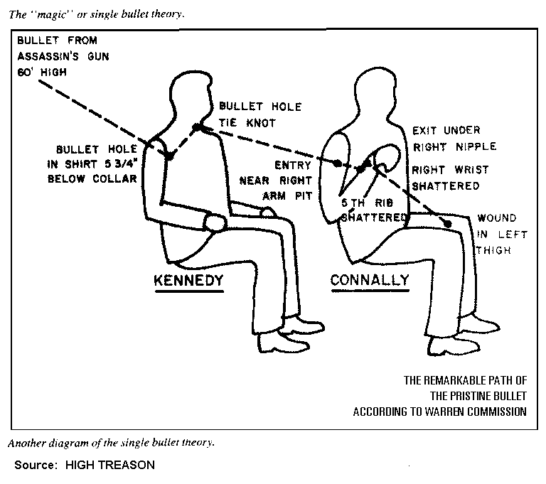
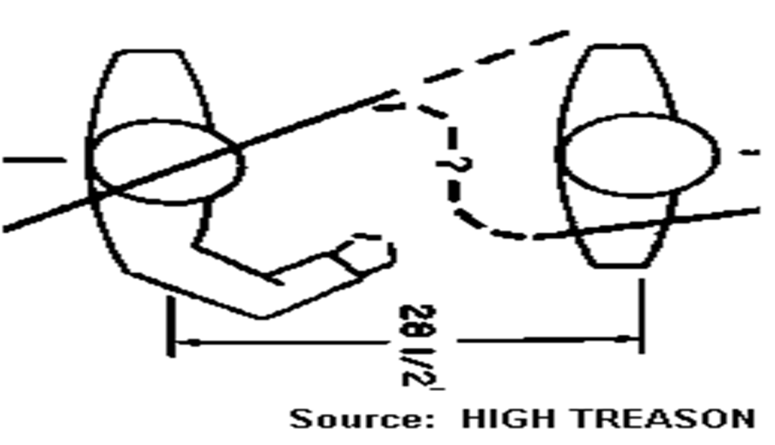
“Magic” or Single Bullet Theory
Notes:
According to the single-bullet theory, a three-centimeter (1.2″)-long copper-jacketed lead-core 6.5-millimeter rifle bullet fired from the sixth floor of the Texas School Book Depository passed through President Kennedy’s neck and Governor Connally’s chest and wrist and embedded itself in the Governor’s thigh. If so, this bullet traversed 15 layers of clothing, 7 layers of skin, and approximately 15 inches of tissue, struck a necktie knot, removed 4 inches of rib, and shattered a radius bone. The bullet was found on a gurney in the corridor at the Parkland Memorial Hospital, in Dallas, after the assassination. The Warren Commission found that this gurney was the one that had borne Governor Connally.^{[3]} This bullet became a key Commission exhibit, identified as CE 399. Its copper jacket was completely intact. While the bullet's nose appeared normal, the tail was compressed laterally on one side.

Slide 6
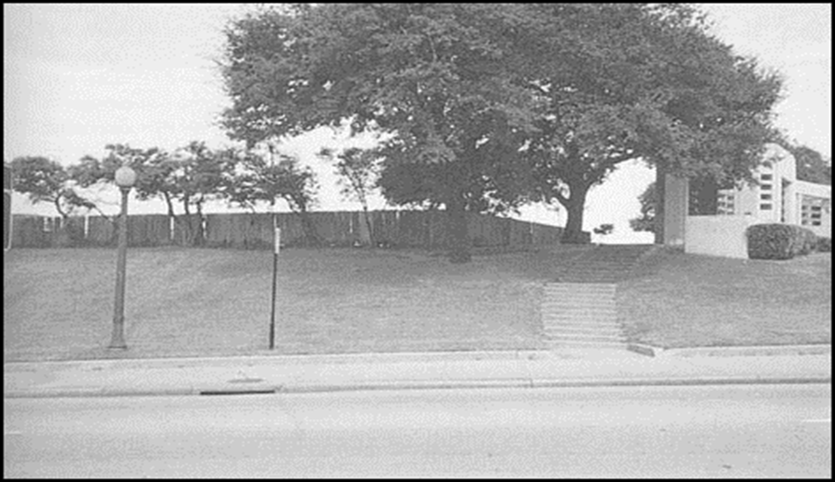
A Second Shooter (from the Grassy Knoll)?
Probably the most popular second shooter theory has a gunman behind the picket fence on the Grassy Knoll.
Behind the fence the shooter would have been able to escape through the railroad yard.
A newer theory states a second shooter crouched in the storm drain.
A theorist was able to enter the drain through the manhole cover and follow the drain out of the plaza.

Slide 7
Suspect Captured in Dallas Theater
Lee Harvey Oswald, 24, a pro-Communist ex-Marine employed at the Texas School Book Depository Building
  While police officers searched through the building, Oswald had left
  Found an Italian-made 6.5mm. Mannlicher-Carcano rifle, fitted with a Japanese 4-power telescope sight near the 6th floor window (assassination weapon).
A patrolman saw a man answering the broadcast description and went to question him
  Oswald removed a revolver, fired 4 shots into the officer, and fled.
  While searching, police got a call from the cashier of the Texas Theater, 6 blocks from the patrolman’s murder, to report a man acting suspicious.
  Police found him in the theater, where he tried to commit suicide using a .38-caliber revolver, but the officers disarmed him after he had pulled the trigger at least once without it firing.
Upon continuous interrogation, Oswald denied shooting anyone
  Paraffin tests proved, however, that he had recently discharged a firearm.
The Communist Party of the U.S.A. denounced the assassination “as a monstrous crime against the country” and denied that Oswald had any association with them.
Notes:
Oswald was in custody for approx. 48 hours. Though he was questioned by police for most of that time, no official record of what he told the police was ever released. The police claimed they didn’t take notes.
On a number of occasions the press were able to question Oswald. Oswald never had an attorney present. (This occurred before the Miranda v. Arizona case where the Supreme Court stated people must be “read their rights.”)
Oswald told reporters he was charged with the shooting of Officer Tippitt. It was the press who first told Oswald of his being the suspect in the shooting of President Kennedy.
On November 23rd the FBI took over the case and took any evidence the Dallas police department had gathered.

Slide 8
Oswald’s Background
Reared in poverty
Self-described Marxist and Secretary of the New Orleans chapter of the pro-Castro Fair Play for Cuba Committee (no charter issued in that area…)
Loner, bookish (grades often below average however), and opposed to discipline
  “Emotionally quite disturbed youngster” who had a “personality pattern disturbance with schizoid features and passive-aggressive tendencies”.
By 16 he quit school to work, when he began to read Communist literature
Joined the Marines at 17 – court martialed twice for failing to register a weapon and for using profanity to a noncommissioned officer.
1959 – announced his desire to renounce his U.S. citizenship (discharged officially from the Marines) and affirmed his allegiance to the Soviet Socialist Republic
When trying to leave the USSR with his wife (a Russian pharmacist) he claimed Soviets refused his permit – U.S. State Department granted him money for travel expenses for them to leave with her and their infant daughter.
In 1963 - living in Dallas, Oswald attempted to kill a retired U.S. Army Major known for extreme ritious views and attempted to join the anti-Castro Cuban Student Directorate in New Orleans (previously forming the fictitious pro-Castro Fair Play for Cuba Committee)
Night prior to Kennedy’s assassination, Oswald visited his family (living in Irving, Texas while he worked in Dallas) – he said he was bringing back curtain rods for his Dallas apartment (rifle bag).
  Mrs. Oswald found his wedding ring and his wallet on her dresser.

Slide 9
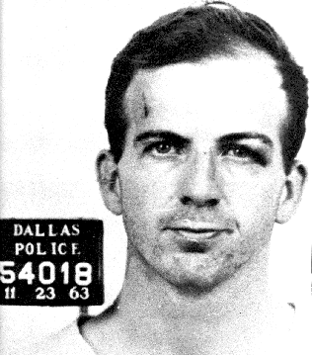
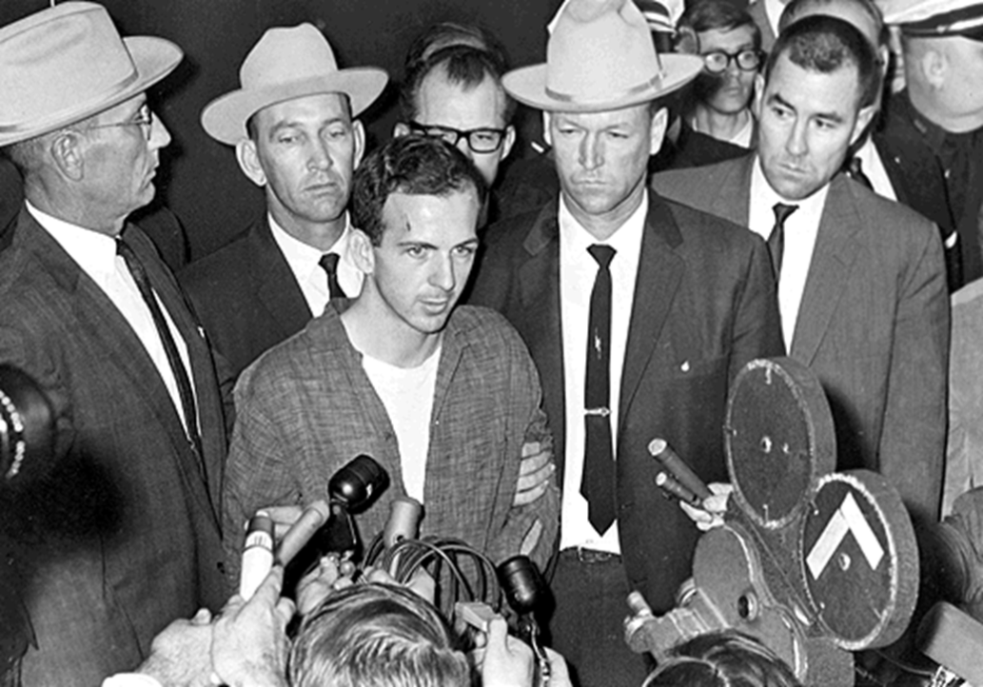
Lee Harvey Oswald

Slide 10
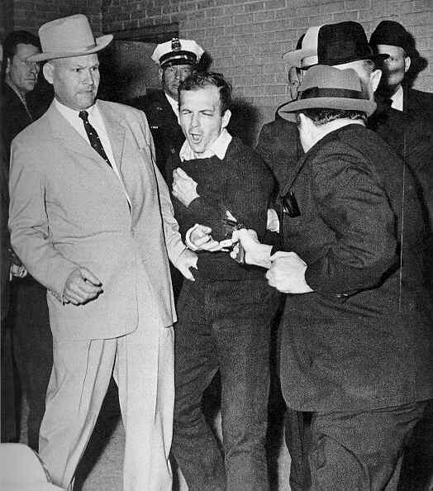
Oswald Slain
Oswald was fatally shot on Nov. 24, 1963 while being transferred from the city jail to the Dallas county jail.
Jack Ruby, Dallas night-club operator fired a single shot into his side (darted out from the group)
Oswald never admitted any connection to the assassination
Ruby was immediately arrested and denied that his act was in any way connected with a conspiracy to assassinate President Kennedy – state of rage and depression over Kennedy’s death.
Oswald’s death took place before “live” TV cameras and was witnessed by TV viewers throughout the country
President Johnson ordered the FBI to check into “every aspect” of Oswald’s murder

Slide 11
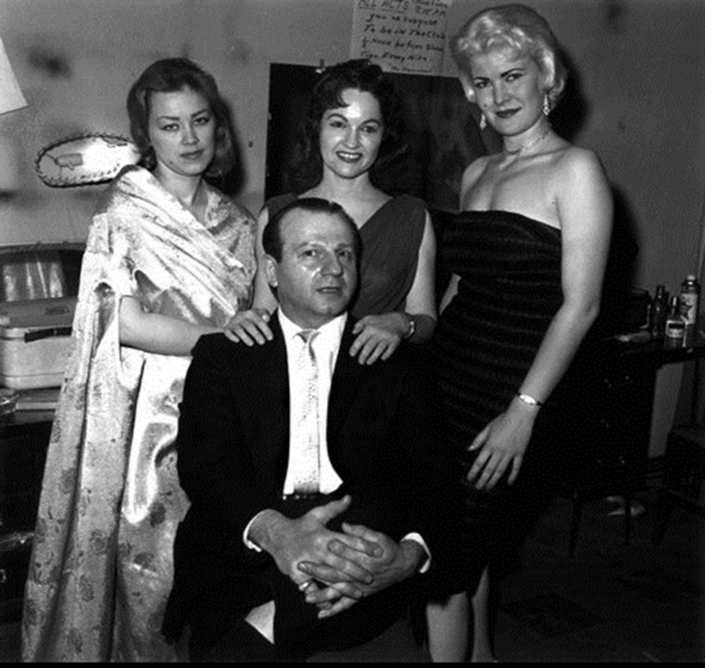
Jack Ruby
Jack Ruby was a well known strip club owner in the Dallas area.
Rumors persisted that Ruby had long time connections with the mafia.
The Warren Commission concluded Ruby, distraught by the death of JFK, took it upon himself to kill Oswald.
Many believe Ruby killed Oswald in an effort to help cover up the assassination conspiracy.
While in prison a few years later, Ruby died of cancer.

Slide 12
Reactions of the Assassination
The Nation Mourns
  President Johnson issued a proclamation designating November 25, the day of JFK’s funeral “to be a day of national mourning throughout the United States”
    Americans were asked to assemble at their places of worship
    TV and radio networks and stations canceled all entertainment programs and commercial announcements Nov. 22-25 to devote their time almost exclusively to the assassination and related events.
    Stores, government and business offices, theaters, and other establishments were shut down Nov. 22-25
    Trading on the New York Stock Exchange along with several railroads ordered their trains to halt for a minute or two in honor of the murdered President.
  Republican Presidential candidate Barry Goldwater commented that the mind that murdered Kennedy was one fed by communism not American philosophies.
Anti-Kennedy reactions (very few) included applauding schoolchildren in Dallas.
World Reaction
  Soviet Premier Nikita S. Khrushchev and his wife sent personal messages of sympathy to Mrs. Kennedy and official messages to President Johnson.
  Fidel Castro declared that the assassination “is grave and bad news” despite the fact that the Eisenhower and Kennedy Administrations “have been characterized by a spirit of aggression and hostility… Cubans don’t hate men. We hate the imperialist and capitalist system… The death of a man, although this man is an enemy, does not have to cause us joy.”
  Communists opposed any kind of assassination – even if the one assassinated is hostile [to China].

Slide 13
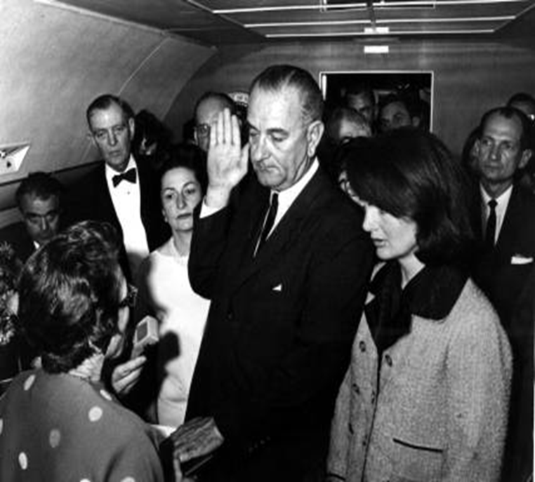
Lyndon Johnson as President
Continues Kennedy’s Programs
  First public foreign policy statement – to Latin Americans to “reaffirm” the Alliance for Progress – living memorial to Kennedy.
  First appearance before Congress – told a joint session he wished for the “earliest possible passage of civil rights and tax-cut legislation”.
  Determined to continue America’s thrust forward under Kennedy – conquering space, partnership across the Atlantic and Pacific, Peace Corps, education for all, jobs, care for our elderly, and equal rights for all whatever their races or color.
  Keep its commitments from South Vietnam to West Berlin – searching for peace.
Notes:
He called on ex-President’s Eisenhower and Truman and at his first cabinet meeting asked all cabinet members to stay and help him rather than submitting letters of resignation, which is customary when a new President took office).
“No memorial oration or eulogy could more eloquently honor President Kennedy’s memory” than prompt enactment of a civil rights bill.

Slide 14
Warren Commission
  President Johnson appointed a special commission, to investigate Kennedy’s assassination and the murder of Lee Harvey Oswald.
    Communist Party of the U.S.A. forwarded its correspondence with Oswald to the commission asserting that “Oswald was never a Communist or a Marxist.”
  6 Areas of Inquiry: 1) All activities of Oswald the day of the assassination, 2) Oswald’s life and background, his associations, ideas and psychology, 3) Oswald’s Marine Corps service and his life in the Soviet Union, 4) The murder of Oswald by Jack Ruby, 5) Ruby’s story, 6) What was done to protect Kennedy?
  No lawyer was appointed to represent Oswald because the commission was not aimed at determining the guilt of anyone – it was a fact-finding body.
  Report included: a) Lee Harvey Oswald was Kennedy’s assassin, b) Oswald had acted alone and had not conspired with anybody, c) there had been no connection between Oswald and Ruby – some suspicions that Oswald had been involved in a conspiracy and had been silenced by Ruby to protect the other conspirators.
  No evidence that the Soviet Union or Cuba were involved in the assassination
  Oswald’s motive was deemed unclear – many factors undoubtedly involved:
    Deep-rooted resentment of all authority
    Inability to enter into meaningful relationships and a continuous pattern of rejecting his environment
    Urge to try to find a place in history and despair at times
    Capacity for violence as evidence by his attempt to kill earlier
    Avowed commitment to Marxism and communism – developed his own interpretation of them.
Notes:
In contrast to the conclusions of the Warren Commission, the United States House Select Committee on Assassinations (HSCA) concluded in 1978 that Kennedy was probably assassinated as a result of a conspiracy.^{[10]} The HSCA found the original FBI investigation and the Warren Commission Report to be seriously flawed. While agreeing with the Commission that Oswald fired all the shots which caused the wounds to Kennedy and Connally, the HSCA stated that there were at least four shots fired (only three of which could be linked to Oswald) and that there was "...a high probability that two gunmen fired at [the] President."

Slide 15
Coincidence…?
Abraham Lincoln
John F. Kennedy
Abraham Lincoln was elected to Congress in 1846.
Abraham Lincoln was elected President in 1860.
Lincoln's secretary was named Kennedy.
Andrew Johnson, who succeeded Lincoln, was born in 1808.
John Wilkes Booth, who assassinated Lincoln, was born in 1839.
Lincoln was shot at the theater named 'Kennedy'.
Booth ran from the theater and was caught in a warehouse.
A week before Lincoln was shot, he was in Monroe, Maryland.
John F. Kennedy was elected to Congress in 1946.
John F. Kennedy was elected President in 1960.
Kennedy's secretary was named Lincoln.
Lyndon Johnson, who succeeded Kennedy, was born in 1908.
Lee Harvey Oswald, who assassinated Kennedy, was born in 1939.
Kennedy was shot in a car called 'Lincoln'.
Oswald ran from a warehouse and caught in a theater.
A week before Kennedy was shot, he was with Marilyn Monroe.

Slide 16
“Coincidence” Continued
The names Lincoln and Kennedy each contain seven letters.
Both were particularly concerned with civil rights.
Both wives lost their children while living in the White House.
Both Presidents were shot on a Friday.
Both Presidents were shot in the head.
Booth and Oswald were assassinated before their trials.
Both assassins were known by their three names.
Both names are composed of fifteen letters.
Both were assassinated by Southerners.
Both were succeeded by Southerners.
Both successors were named Johnson.

